Slide 1
FEA LAB PROJECT

Slide 2
Ojectives to be covered
Procedure of static structural .
Convergence in static structural.
Procedure of transient structural.
Convergence in transient structural.

Slide 3
Static structural analysis
Static structural analysis is a type of FEA in ANSYS used to determine how a
structure behaves under loads that do not change with time.

Slide 4
Procedure
selecting static strucutral from ANSYS Workbench Project Schematic
Defining material property in engineering data
Defined material property based on instruction.
Creating geometry & assigning material
conducting simulation
Defining what sort of analysis to do.
Created a hexagon with extrusion of 20mm in modular geomerty & assigned material in model analysis.
Conducted stress and strain simulation based on different mesh sizes

Slide 5
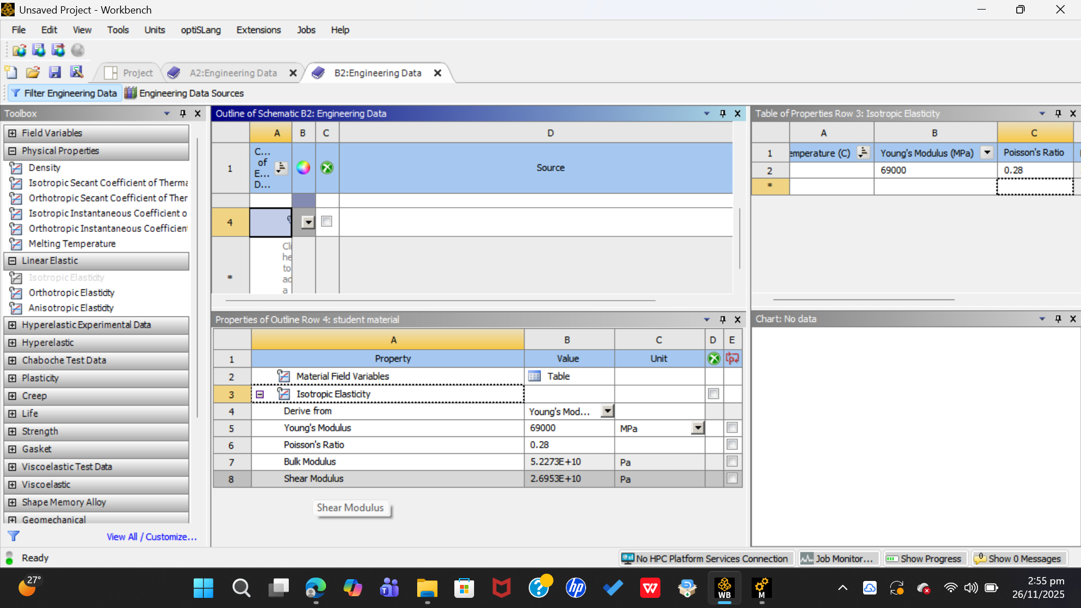
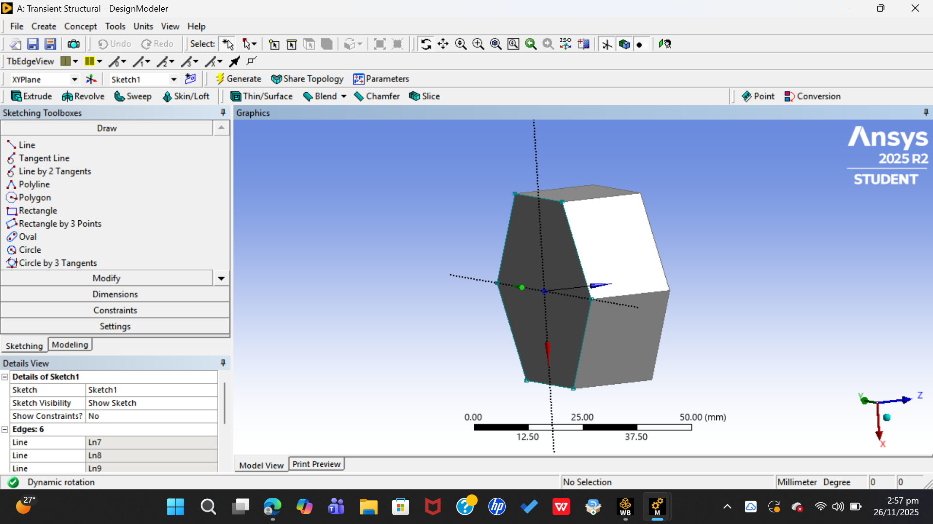
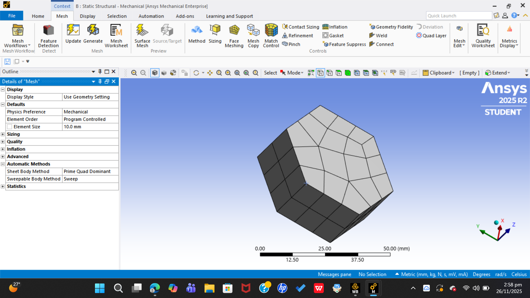
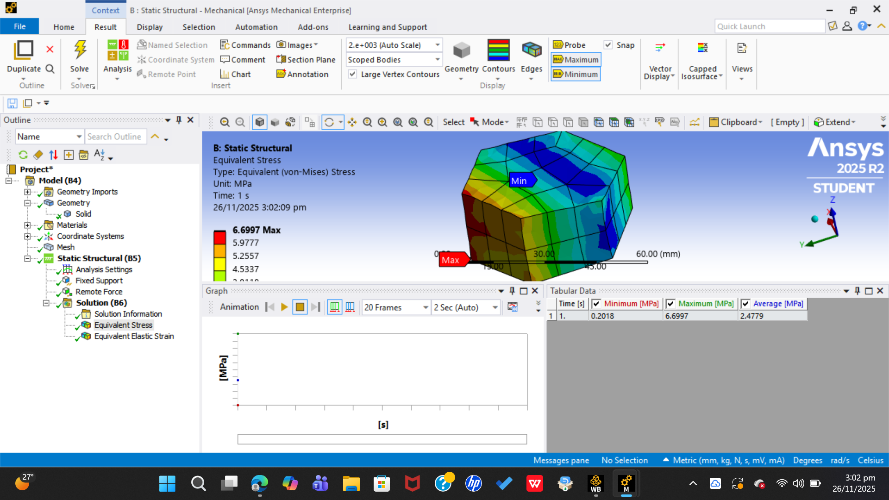

Slide 6
Defining material properties
Opened Engineering Data from the Project Schematic to set up material properties for our simulation.
Created a new custom material to match the requirements of our project experiment.
Used the project rule for stiffness:
Young’s Modulus (E) = last two digits of Roll No. (in MPa)
For our case: E = 69 MPa.
Assigned the standard value for Poisson’s Ratio as specified:
ν = 0.28.
Density was not required for static analysis, so it was left undefined (as static structural does not use mass-related effects).
Saved the material and ensured it was assigned to the imported geometry inside the Static Structural model.

Slide 8
Defining Geometry (Transient Structural)
Created the base geometry for the simulation using SpaceClaim/DesignModeler.
Drew a hexagonal cross-section to represent the sample element for loading analysis.
Ensured that all edges and dimensions were cleanly constrained for accurate meshing later.
Extruded the hexagon by 20 mm to form a solid 3D body for transient loading.
Verified geometry orientation to correctly apply the fixed support on one face and time-varying force on the opposite face.
Saved and updated the geometry so it automatically transferred into the Transient Structural system.

Slide 10
Mesh Refinement (Coarse to Fine)
Generated the initial mesh using default (coarse) element size to observe baseline stress and strain values.
Gradually refined the mesh by reducing element size in controlled steps (e.g., 10 mm → 7 mm → 4 mm → 3 mm).
Ensured consistent mesh settings across all runs so that only element size changed, keeping the comparison valid.
Re-solved the analysis after each refinement to record the corresponding stress and strain outputs.
Used the results of each mesh size to evaluate convergence and identify the mesh that balances accuracy with computational efficiency.
Exported all readings for further comparison in the CSV file and graphs created later

Slide 12
Generating Stress–Strain Results for Each Mesh Size
For every selected mesh size (10 mm, 7 mm, 4 mm, 3 mm), we ran a separate stress and strain solution under the same loading(2809N sum of date of birth) and boundary conditions.
After each solve, we extracted the maximum stress and maximum strain from the results section.
Ensured that the values were taken from the same loading instant so comparisons remained consistent.
Recorded stress and strain readings into a table to track how the results changed with mesh refinement.
Exported all readings into a CSV file for plotting stress-vs-mesh-size and strain-vs-mesh-size graphs.
Used these comparisons to observe convergence, ensuring the solution becomes stable as the mesh becomes finer.

Slide 13
Mesh convergence result
Mesh Size (mm) | Sum of Max Elastic Strain (mm/mm)
3 | 0.00014476
4 | 0.00013101
7 | 0.00011116
10 | 0.00010403
Grand Total | 0.00049096
Mesh Size (mm) | Max of Max von-Mises Stress (MPa)
3 | 9.99
4 | 9.85
7 | 9.3
10 | 8.9
Grand Total | 9.99

Slide 14
Mesh convergence result
The result shows that as you make the mesh more refined the reading of stress and strain tend to increase but the amount by which it does so decreases with each increment of mesh refinement eventually the graph starts to flatten and this is what mesh convergence tends to imply

Slide 15
Transient structural analysis
Static structural analysis is a type of FEA in ANSYS used to determine how a
structure behaves under a load that do change with time.

Slide 16
Procedure
selecting transient strucutral from ANSYS Workbench Project Schematic
Linking geometry with static structural
Defining time increment
Number of steps and time increment of each step were defined.
conducting simulation
Defining what sort of analysis to do.
A different step was to link geometry in transient with that of static structural
Conducted stress and strain simulation based on different mesh sizes

Slide 17
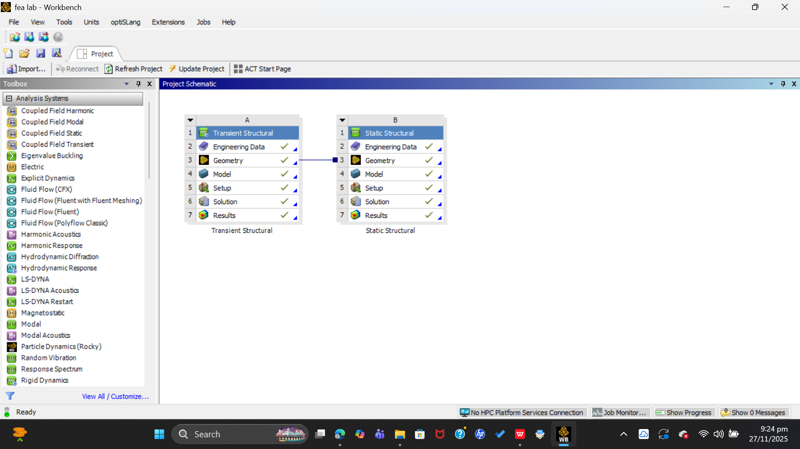
Linking static structural
Linking Geometry from Static to Transient Structural
Added a Transient Structural system directly below the Static Structural system in the Project Schematic.
Dragged the Geometry cell of the Static Structural system and connected it to the Geometry cell of the Transient Structural system.
This created a shared-geometry link, ensuring both analyses used the exact same 3D model without needing to recreate it.
The link allowed any geometry updates in Static Structural to automatically reflect in the Transient Structural setup.
Helped maintain consistency across both analyses, especially important when applying the same supports and loading surfaces.
Ensured faster workflow by avoiding duplication and keeping the model synchronized throughout the study.

Slide 18
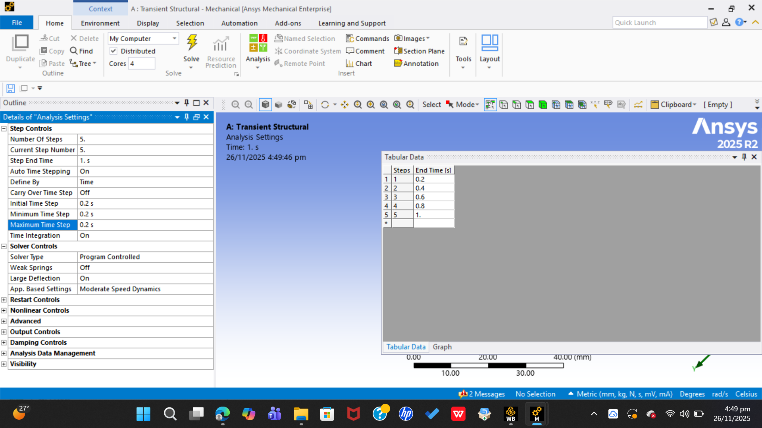
Defining Time Steps for Transient Structural
Opened the Analysis Settings in the Transient Structural system to specify time-dependent behavior.
Set the total simulation time to 1 second, since the applied force was intended to act over this duration.
Divided the total time into 5 equal steps, choosing a 0.2-second interval for smooth and controlled variation of the applied load.
This time resolution ensured that the tabular force input (based on the PKR–USD conversion value) could be applied gradually and accurately.
The selected step size provided a balance between numerical stability and computational efficiency.
Confirmed time-step setup before applying the time-varying remote force.

Slide 19
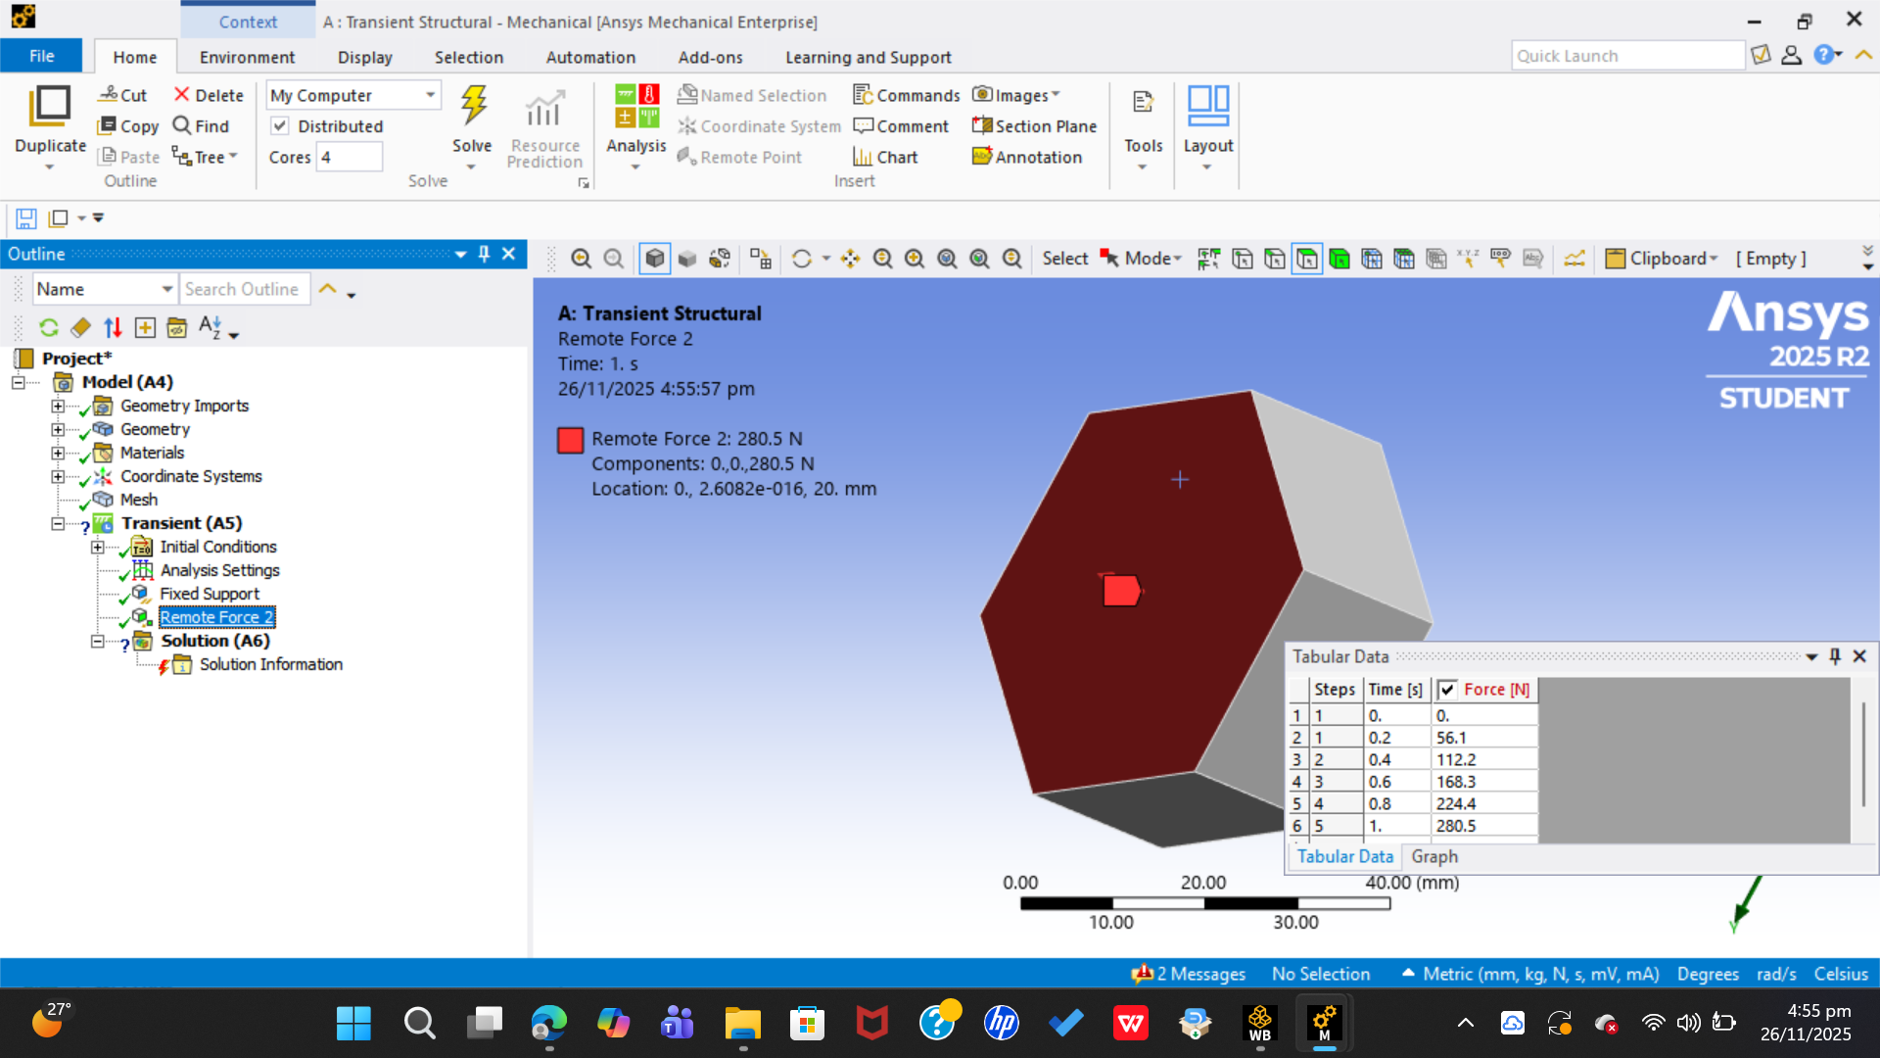
Defining Time Steps for Transient Structural
Inserted a Remote Force on the face opposite the fixed support to simulate the applied load.
Selected Tabular Time as the input method to allow the force to vary over the 1-second duration.
Used the USD → PKR conversion rate (280.5) as the reference magnitude for the applied force.
Distributed this force across the 5 time steps (0, 0.2, 0.4, 0.6, 0.8, 1.0 seconds) to create a smooth loading curve.
Entered the force values in the table so that the load increased gradually from zero up to the maximum value (i.e., 280.5 N) at 1 second.
Ensured direction, application point, and vector orientation were consistent with the problem setup.
Verified the force-time graph in ANSYS to confirm the correct variation of force throughout the 1-second interval.

Slide 20
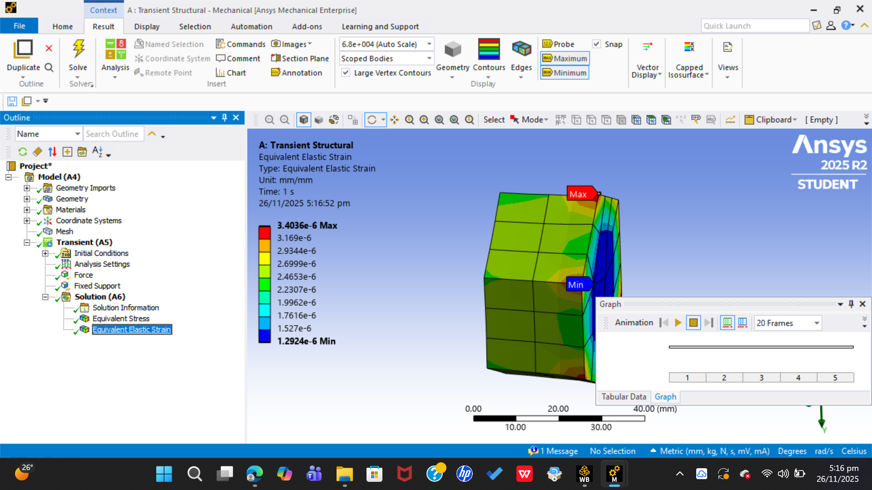
Stress Analysis Across Mesh Sizes
Performed separate transient analyses for each selected mesh size (10 mm, 7 mm, 4 mm, and 3 mm).
After each simulation, extracted the maximum stress value from the results section (Stress → Equivalent / von Mises).
Ensured the stress readings were taken at the same time point for fair comparison across all mesh sizes.
Recorded the stress values to observe how results change as the mesh becomes finer.
Noted that stress values stabilized as element size decreased, indicating convergence.
Exported the stress readings into a CSV file, later used to plot stress vs. mesh size trends.
Used this comparison to identify the optimal mesh size balancing accuracy and computational cost.

Slide 21
Mesh convergence
Mesh Size (mm) | Max of Maximum stress in MPA
3 | 0.34999
4 | 0.31348
7 | 0.26267
10 | 0.23485
Grand Total | 1.16099
Grand Total | 1.16099
result show mesh convergence for transient strcutral as well with each mesh refinement the stress is increasing but the amount by which it increases tends to decrease with each mesh refinement causing the curve to flatten which implies mesh convergence

Slide 22
THANK YOU!
.

